Slide 1
MG Optimization

Slide 2
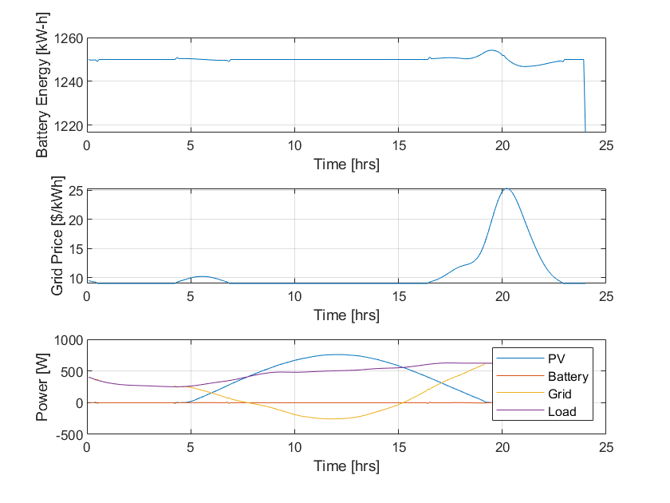
battSolarOptimize_ver1
function [Pgrid,Pbatt,Ebatt] = battSolarOptimize_ver1(N,dt,Ppv,Pload,Einit,Cost,FinalWeight,batteryMinMax)
% Minimize the cost of power from the grid while meeting load with power
% from PV, battery and grid
prob = optimproblem;
% Decision variables
PgridV = optimvar('PgridV',N);
PbattV = optimvar('PbattV',N,'LowerBound',batteryMinMax.Pmin,'UpperBound',batteryMinMax.Pmax);
EbattV = optimvar('EbattV',N,'LowerBound',batteryMinMax.Emin,'UpperBound',batteryMinMax.Emax);
BattWearCost = optimvar('BattWearCost', N, 'LowerBound', 0);
% Minimize cost of electricity from the grid
prob.ObjectiveSense = 'minimize';
prob.Objective = dt * Cost' * PgridV - FinalWeight * EbattV(N) + BattWearCost(N);
% Power input/output to battery
prob.Constraints.energyBalance = optimconstr(N);
prob.Constraints.energyBalance(1) = EbattV(1) == Einit;
prob.Constraints.energyBalance(2:N) = EbattV(2:N) == EbattV(1:N-1) - PbattV(1:N-1)*dt;
% battery Wear Cost input/output
E_cap = 2500;
prob.Constraints.battDeg = optimconstr(N);
prob.Constraints.battDeg(1) = BattWearCost(1) == 0;
prob.Constraints.battDeg(2:N) = BattWearCost(2:N) == BattWearCost(1:N-1) + E_cap * (phi(EbattV(2:N)) - phi(EbattV(1:N-1)));
% Satisfy power load with power from PV, grid and battery
prob.Constraints.loadBalance = Ppv + PgridV + PbattV == Pload;
% initial sturcture
x0.PgridV = zeros(N,1);
x0.PbattV = zeros(N,1);
x0.EbattV = Einit * ones(N,1);
x0.BattWearCost = zeros(N, 1);
% Solve the linear program
%아래의 둘 중 하나 주석처리 해야 함. 결과는 똑같이 우측과 같음.
options = optimoptions(prob.optimoptions,'Display','none’);
options = optimoptions(‘fmincon’, ‘Algorithm’, ‘interior-point’, ‘Display’, ‘none’);
%options = optimoptions('fmincon', 'Algorithm', 'trust-region-reflective','Display','none');
[values,~,exitflag] = solve(prob,x0,'Options',options);
% Parse optimization results
if exitflag <= 0
% 최적해 없거나 오류는 0을 반환함
Pgrid = zeros(N,1);
Pbatt = zeros(N,1);
Ebatt = zeros(N,1);
else
% 최적해 찾았을 때 값을 넣어줌
Pgrid = values.PgridV;
Pbatt = values.PbattV;
Ebatt = values.EbattV;
end
end
function w_s = WearDensityFunc(s)
% Define parameters
%C_bess_price = 3*10^5; % [$/MWh]
%C_bess_price = 10000/16;
BattCap = 2500;
battPrice = 240000; %[$]
C_bess_price = battPrice / BattCap;
eta_ch = 0.95; eta_dis = 0.95;
A = 694; B = 0.795;
% Calculate Wear Density func w(s)
w_s = (C_bess_price / (2 * eta_ch * eta_dis)) * (B * (1 - s)^(B - 1)) / A;
end
function phi = phi(EbattV)
battEnergy = 9*10^9;
SOC_init = 0.5;
SOC_cur = EbattV / battEnergy;
N = 241;
for t = 2:N-1
phi = (WearDensityFunc(SOC_init) + WearDensityFunc(SOC_cur(t))) * (SOC_cur(t) - SOC_init) / 2;
end
% phi 값을 계산 (배터리 마모 밀도 함수 적용)
% phi_val = zeros(length(SOC_cur), 1);
% for t = 2:1:length(SOC_cur)
% phi_val(t) = (WearDensityFunc(SOC_init) + WearDensityFunc(SOC_cur(t))) * (SOC_cur(t) - SOC_init) / 2;
% end
end
USE – interior-point
Didn’t reflect abs(phi)

Slide 3
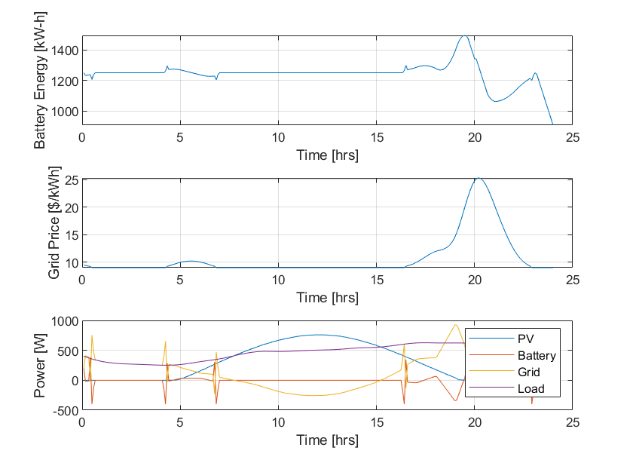
battSolarOptimize_ver1
function [Pgrid,Pbatt,Ebatt] = battSolarOptimize_ver1(N,dt,Ppv,Pload,Einit,Cost,FinalWeight,batteryMinMax)
disp('1')
% Minimize the cost of power from the grid while meeting load with power
% from PV, battery and grid
prob = optimproblem;
% Decision variables
PgridV = optimvar('PgridV',N);
PbattV = optimvar('PbattV',N,'LowerBound',batteryMinMax.Pmin,'UpperBound',batteryMinMax.Pmax);
EbattV = optimvar('EbattV',N,'LowerBound',batteryMinMax.Emin,'UpperBound',batteryMinMax.Emax);
BattWearCost = optimvar('BattWearCost', N, 'LowerBound', 0);
% Minimize cost of electricity from the grid
prob.ObjectiveSense = 'minimize';
prob.Objective = dt * Cost' * PgridV - FinalWeight * EbattV(N) + BattWearCost(N);
% Power input/output to battery
prob.Constraints.energyBalance = optimconstr(N);
prob.Constraints.energyBalance(1) = EbattV(1) == Einit;
prob.Constraints.energyBalance(2:N) = EbattV(2:N) == EbattV(1:N-1) - PbattV(1:N-1)*dt;
% battery Wear Cost input/output
E_cap = 2500;
prob.Constraints.battDeg = optimconstr(N);
prob.Constraints.battDeg(1) = BattWearCost(1) == 0;
prob.Constraints.battDeg(2:N) = BattWearCost(2:N) == BattWearCost(1:N-1) + E_cap * (phi(EbattV(2:N)) - phi(EbattV(1:N-1)));
% Satisfy power load with power from PV, grid and battery
prob.Constraints.loadBalance = Ppv + PgridV + PbattV == Pload;
% initial sturcture
x0.PgridV = zeros(N,1);
x0.PbattV = zeros(N,1);
x0.EbattV = Einit * ones(N,1);
x0.BattWearCost = zeros(N, 1);
% Solve the linear program
%options = optimoptions(prob.optimoptions,'Display','none');
options = optimoptions('fmincon', 'Algorithm', 'interior-point','Display','none');
%options = optimoptions('fmincon', 'Algorithm', 'sqp','Display','none');
[values,~,exitflag] = solve(prob,x0,'Options',options);
% Parse optimization results
if exitflag <= 0
% 최적해 없거나 오류는 0을 반환함
Pgrid = zeros(N,1);
Pbatt = zeros(N,1);
Ebatt = zeros(N,1);
else
% 최적해 찾았을 때 값을 넣어줌
Pgrid = values.PgridV;
Pbatt = values.PbattV;
Ebatt = values.EbattV;
end
end
function w_s = WearDensityFunc(s)
% Define parameters
%C_bess_price = 3*10^5; % [$/MWh]
%C_bess_price = 10000/16;
BattCap = 2500;
battPrice = 240000; %[$]
C_bess_price = battPrice / BattCap;
eta_ch = 0.95; eta_dis = 0.95;
A = 694; B = 0.795;
% Calculate Wear Density func w(s)
w_s = (C_bess_price / (2 * eta_ch * eta_dis)) * (B * (1 - s)^(B - 1)) / A;
end
function phi = phi(EbattV)
battEnergy = 9*10^9;
SOC_init = 0.5;
SOC_cur = EbattV / battEnergy;
N = 241;
for t = 2:N-1
if SOC_cur(t) >= SOC_init
phi = (WearDensityFunc(SOC_init) + WearDensityFunc(SOC_cur(t))) * (SOC_cur(t) - SOC_init) / 2;
else
phi = (WearDensityFunc(SOC_init) + WearDensityFunc(SOC_cur(t))) * (SOC_init - SOC_cur(t)) / 2;
end
end
% phi 값을 계산 (배터리 마모 밀도 함수 적용)
% phi_val = zeros(length(SOC_cur), 1);
% for t = 2:1:length(SOC_cur)N
% phi_val(t) = (WearDensityFunc(SOC_init) + WearDensityFunc(SOC_cur(t))) * (SOC_cur(t) - SOC_init) / 2;
% end
end
USE – sqp
Didn’t reflect abs(phi)

